Slide 1
POLYLINE EDITOR OpenGl C++
Group Members
Hamza Siddiqui (B14101051)
Shariq Naeem (B14101036)
Bilal Zafar (B14101051)
Taimoor Abbasi (B14101112)

Slide 2
Content
Drawing Anything using Line
Automatically Draw an Alphabet when alphabet key is pressed. Also it creates sound of that alphabet.
Edit Criteria
-Begin New Line
-Start Page
-Print Points
-Delete Points

Slide 3
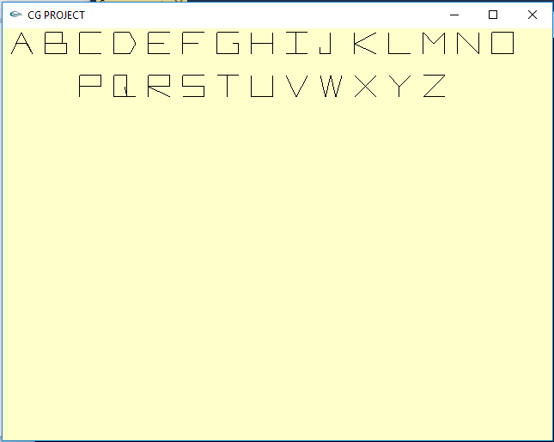
Background
Initially open Alphabets showing window.
void A(myPoint peak, GLint width, GLint height)
{
glBegin(GL_LINE_STRIP);
glVertex2d(peak.x, peak.y);
glVertex2d(peak.x + width / 2, peak.y + height);
glVertex2d(peak.x + width, peak.y);
glVertex2d(peak.x + 3 * width / 4, peak.y + height / 2);
glVertex2d(peak.x + width / 4, peak.y + height / 2);
glEnd();
}
Above Code Draw the “A” alphabet at startup.
Similarly for other Alphabet same code is added with different points.
We set the coordinate of the peak and pass the value of width and height then adjust the aplhabets with respect to peak.

Slide 4
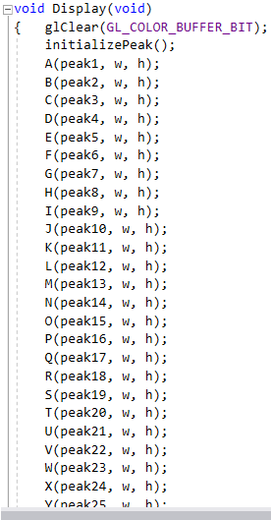
Background
This Shows the Alphabets at Their Position.

Slide 5
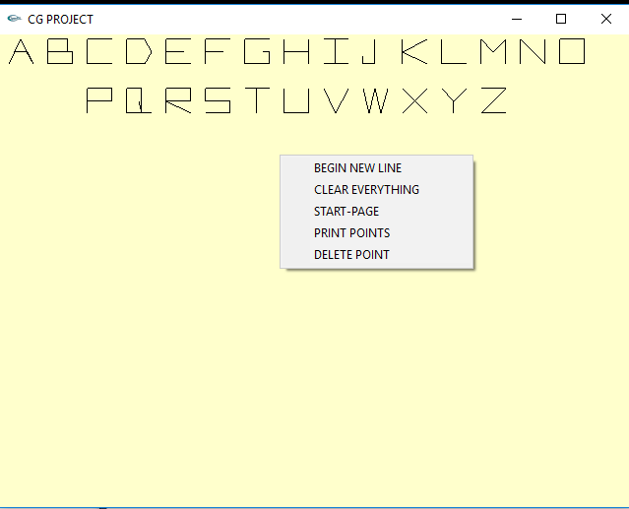
Menu Event
Menu Event creates when right click is pressed.

Slide 6
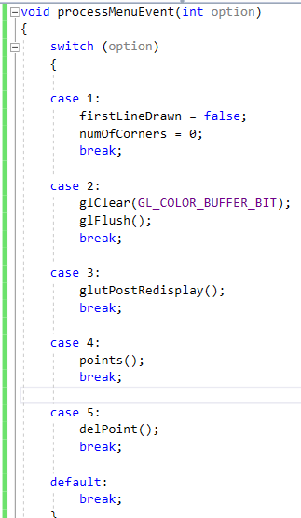
Menu Event

Slide 7
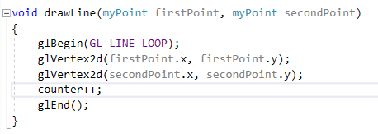
Drawing With Line
Draw line or every that is draw by line we can draw with mouse click.
First click represent the initial point and the second click the final point and draw line between two point and other draw line corresponding to pervious.
We have use the technique of slope such that:
- If difference of y is so small then we will assume it parallel to x-axis.
- If difference of x is so small then we will assume it parallel to y-axis.

Slide 8
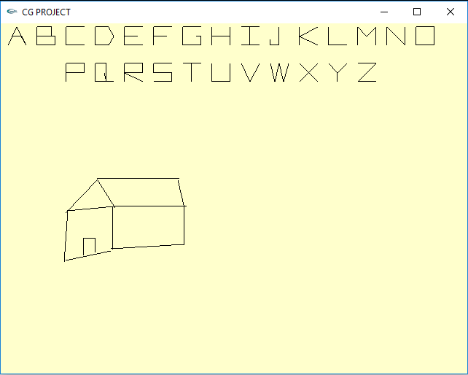
Drawing With Line
Example
Drawing A House

Slide 9
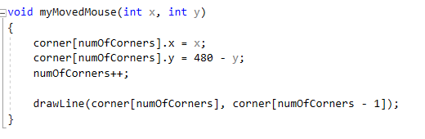
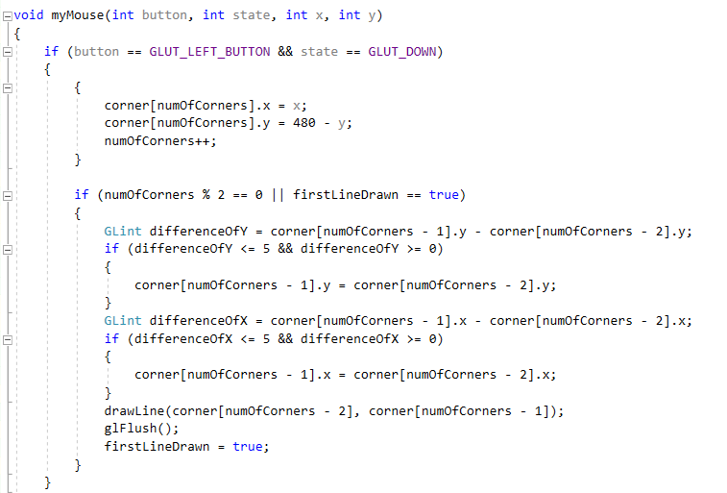
Mouse Interaction

Slide 10
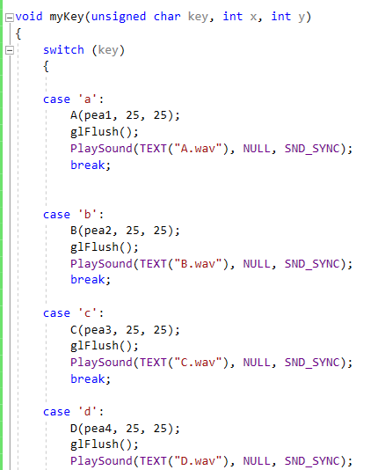
Sound Creation
When we press any alphabet key, it is drawn with dots and a sound of that alphabet hears.

Slide 11
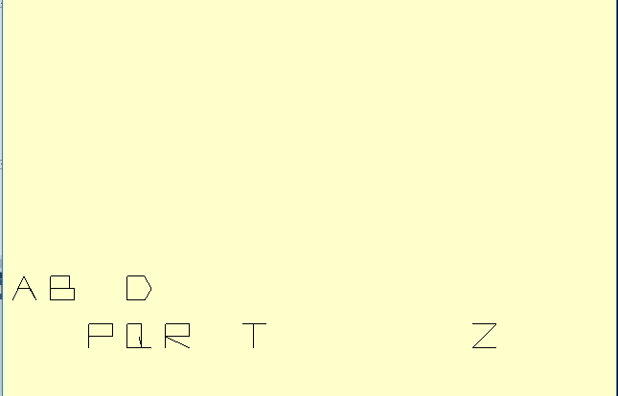
Alphabets Creation

